Slide 1

CSE 145: Brilliant Pad
(Poo Vision)
Richard Chum
Computer Engineering
Derek Lam
Electrical Engineering
Kevin Tain
Computer Engineering

Slide 2

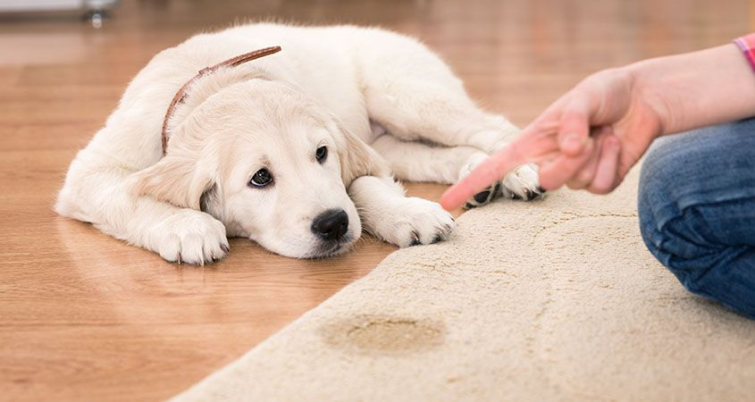
What’s That Smell?
Notes:
What if you’re not home?
Poop smells really bad

Slide 3
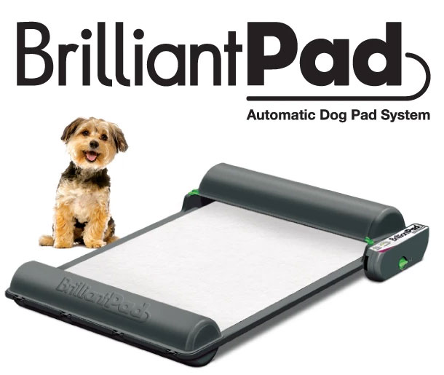
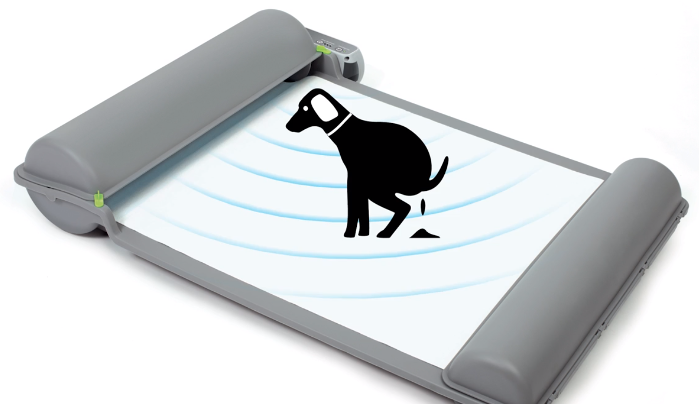
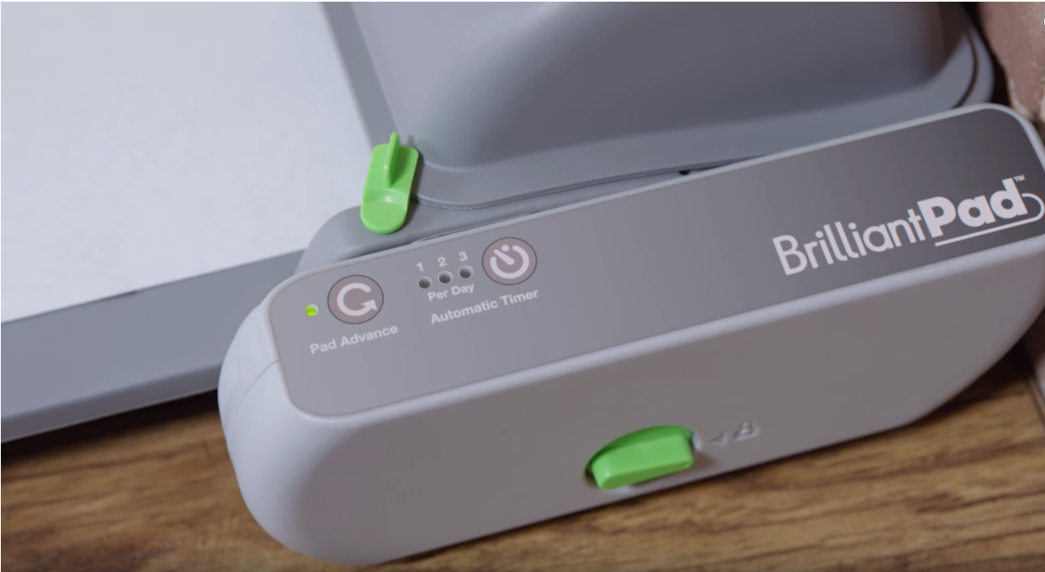
Notes:
World’s first self-cleaning dog potty
Currently features:
Infrared sensors to detect if a dog has entered and left the pad
Advancement of pad through automatic timer or manual press of a button
Had the device for a few months now…. This is a nice product but I wish my brilliant pad was smarter.
Sometimes the pad advances with sparky on it, and sparky doesn’t always go at the same time so sometimes the pad is dirty way before the timer

Slide 4
Brilliant Pad +
More reliably detect the presence of a dog
Determine if a pad is clean or dirty
Determine “how dirty” a pad is (10%, 20%, etc.), and allow users to choose when a pad should be advanced and then replaced

Slide 5
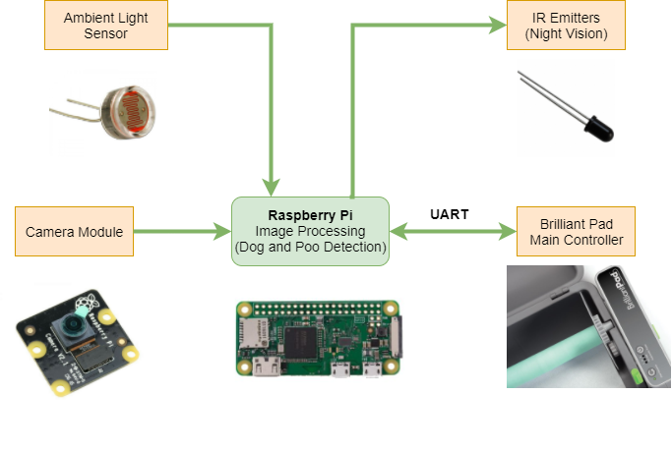
Vision System Block Diagram

